Slide 1

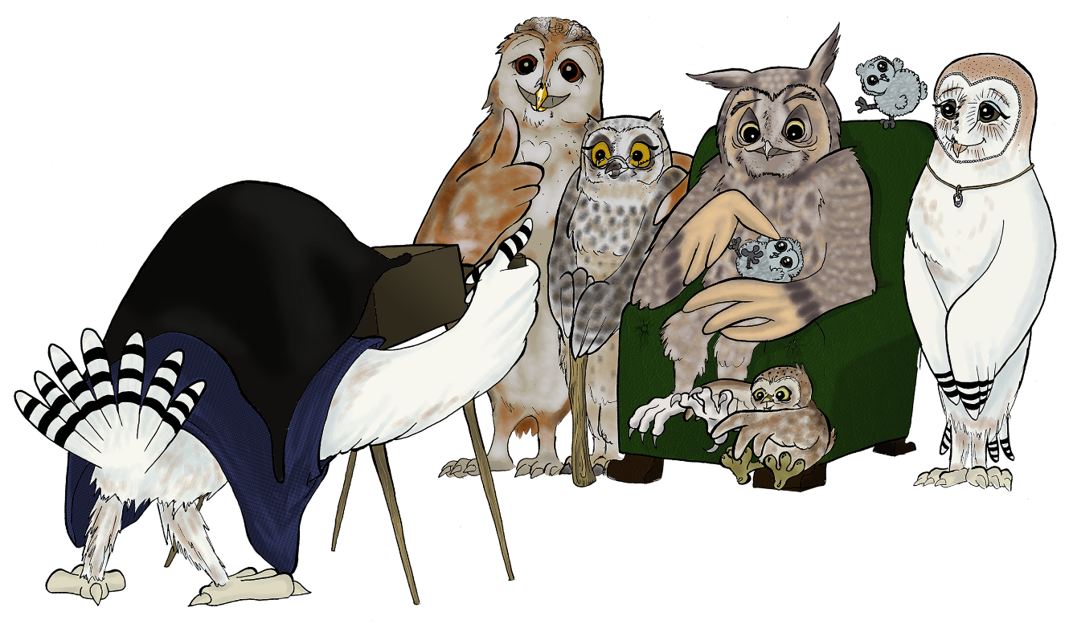
Coach supervision
Supervising in-house coaches
Notes:
Thank you for this opportunity to speak about the shadow, which is a concept I have found useful for many years both in understanding myself and my supervisees and clients.
Before I start I would like invite you all to take a few moments to settle and centre yourselves. Please draw your attention into yourself and focus upon your breath. Just notice as you breath in and out. Pause. Now deepen your breath so that you breathe into the full capacity of your lungs. On your next in breath draw your breath in fully and then hold your breath for a count of three and then breath out. Do that twice more please.
Thank you, I hope that will help you listen to what I have to say with your feelings and your body, as well as your mind.

Slide 2
Supervising in-house coaches
Issues reported by supervisors of in house coaches highlighted by Katherine St John-Brooks (2014) – from her research*.
Clients present with more issue based agendas and coaches can feel pushed towards mentoring or addressing what belongs in line management.
Quite frequent conflicts of confidentiality and role (dual relationships?)
Coaching – counselling boundary issues more frequent.
Coaches finding clients are not always fully committed.
Greater frequency of client cancellations – can lead to appointment drift.
*St John-Brooks, K. (2010) ‘What are the ethical challenges involved in being an internal coach?’ International Journal of Mentoring and Coaching VIII(1): 50-66.
www.steve-page-yorks.co.uk

Slide 3
Supervising in-house coaches (2)
Issues reported by supervisors of in house coaches highlighted by Katherine St John-Brooks (2014) – from her research*.
Coaches often report anxieties about three-way meetings with client and manager because:
  Difficulties in organising,
  Nervous of handling the conversation,
  Difficult in asserting need for clarity of coaching purpose,
  Worries about credibility with manager.
Low client numbers leading to low coach confidence,
Reinforcement of organisational frustrations between coach and client
www.steve-page-yorks.co.uk

Slide 4

Any questions or comments?
www.steve-page-yorks.co.uk

