Slide 1

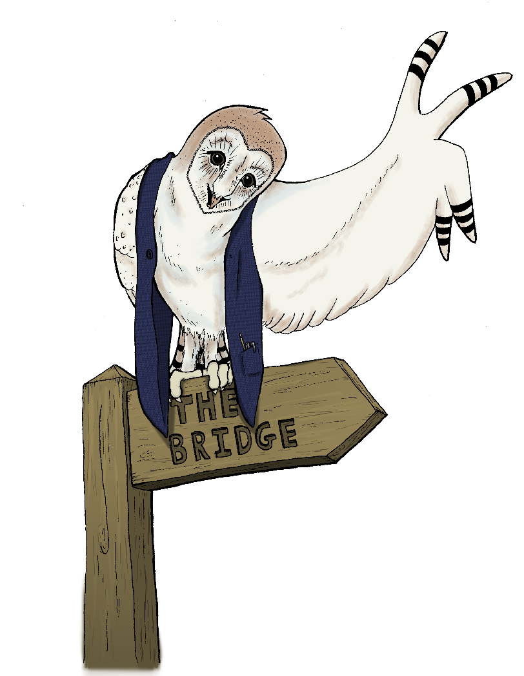
The Cyclical Model of Supervision
“competent practitioners usually know more than they can say. They exhibit a kind of knowing-in-practice, most of which is tacit.”
Donald A. Schön, The Reflective Practitioner: How Professionals Think in Action 1994
Notes:
Thank you for this opportunity to speak about the shadow, which is a concept I have found useful for many years both in understanding myself and my supervisees and clients.
Before I start I would like invite you all to take a few moments to settle and centre yourselves. Please draw your attention into yourself and focus upon your breath. Just notice as you breath in and out. Pause. Now deepen your breath so that you breathe into the full capacity of your lungs. On your next in breath draw your breath in fully and then hold your breath for a count of three and then breath out. Do that twice more please.
Thank you, I hope that will help you listen to what I have to say with your feelings and your body, as well as your mind.

Slide 2

The Cyclical Model
The Cyclical Model was designed in the early 1990’s to meet three purposes:
  A framework for a supervision session,
  A framework for a supervisory relationship,
  A model to use in training supervisors
Originally intended for supervisors of counsellors, it has since been applied to supervision (and mentoring) in a range of other professional relational settings, including coaching.
The full model is available in:
Page & Wosket (2014) Supervising the Counsellor and Psychotherapist 3rd edn, London: Routledge.
www.steve-page-yorks.co.uk email@steve-page-yorks.co.uk
Notes:
Can I just check, is there anyone who for any reason cannot read my slides?
Okay – so I don’t need to read them out.
So I will touch upon personal and professional shadow and I will explain those terms.
Please don’t be fooled by the simplification required in a 45 minute presentation – this is complex and multi-layered material.

Slide 3
The five stages of the model
The inner circle represents the supervisory relationship
The outer circle represents the context in which supervision takes place
The arrows indicate the typical progression between stages
Review
Contract
Bridge
Focus
Space
Notes:
For me what stands out in the quote from Jung are that shadow material tends to have a strong emotional nature and that this gives it a possessive quality – in the moment we are living it has an emotionally consuming quality.

Slide 4
Contract
A supervision contract is an agreement entered into by key stakeholders that contains, supports, gives structure, establishes informed participation by those involved and provides direction and purpose to the work undertaken.
Contracting performs a vital function in underpinning the process and relationship.
A clear and specific contract sets the agenda for the task and process, reduces anxiety by helping to de-mystify what will occur and lays down the ground rules.
Contracting needs to occur at the beginning of any supervisory relationship.
It can also occur as re-contracting throughout the ongoing work. When re-contracting is occurring at various intervals this is usually the sign of a healthy and growing relationship and a developing task.
www.steve-page-yorks.co.uk email@steve-page-yorks.co.uk
Notes:
Paraphrase each of the statements

Slide 5
Focus
The Focus of a supervision session is the subject or material under consideration at that particular point or stage of the supervision process.
Focusing normally starts with the supervisee presenting one or more aspects of their coaching work to explore with their supervisor.
The function of the Focus stage is to ensure that supervision starts with an issue of significance to the supervisee, that the issue and the desired outcome from the supervisory exploration is understood by supervisor and supervisee.
Focusing as a process encourages the supervisee to take responsibility for making the best use of the supervision opportunity.
It encourages intentionality (direction and purpose), reflection and preparation for supervision.
www.steve-page-yorks.co.uk email@steve-page-yorks.co.uk
Notes:
This is an exercise you will do on your own, within your consciousness and I will not ask you to tell anyone else anything about what comes up for you.
Place your attention within yourself, Take a couple of calming breaths.
In a moment I am going to give you an instruction and I want you to simply notice the first thought that comes to mind.
Please think about someone towards whom you have a really strong negative emotional reaction; they really get up your nose.
Don’t try and make sense of it – just notice the first person who comes to mind.
Now focus your attention on them and on your feelings towards them – what is it about them that you react to so strongly? Take a few moments to really bring that to mind.
Okay, next stage – how would it be for you if what you react to in them is actually part of you?
Take a moment to stay with that possibility and jot down anything you want ot about that exercise to help you go back to it if you wish to.

Slide 6
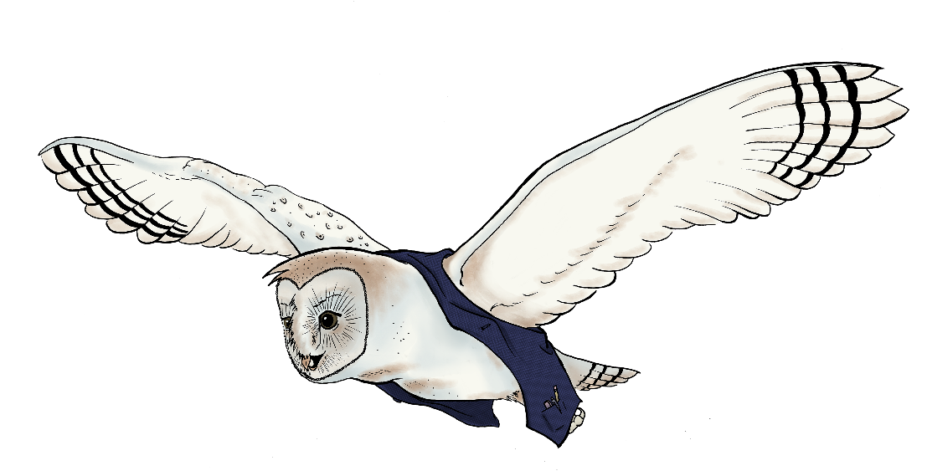
Space
Creating and holding Space is at the heart of the supervision process.
It is the place where the supervisee is held, supported, challenged and affirmed in his or her work.
Space is where movement and insight can occur as a result of the exploratory work undertaken by the supervisor and supervisee.
It is also the place where ‘not knowing’ and confusion are accepted and tolerated in the belief that time and attention given to the client and to the coach are beneficial to the coaching process, even when a clear and comfortable resolution of issues may not be achieved.
It is also where most supervision time is likely to be spent as it is usually here that the deepest reflection takes place.
www.steve-page-yorks.co.uk email@steve-page-yorks.co.uk
Notes:
That was a projection exercise. If we had longer we could explore it in more detail, but I hope that gives you a little glimpse of what I am talking about.
Please note my third point on the slide – sometimes we do seem to have to really jolt ourselves into awareness of some part of our shadow.

Slide 7
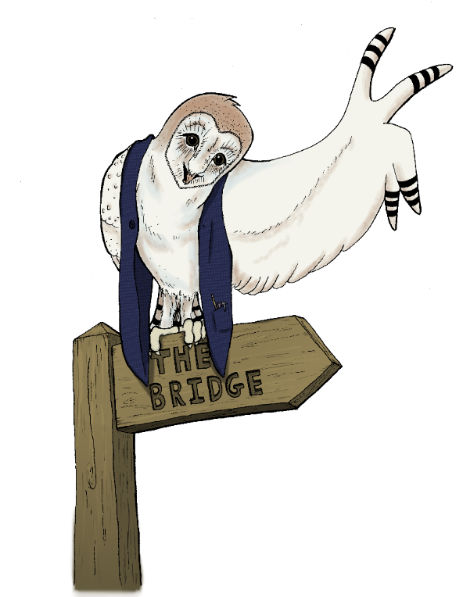
Bridge
The function of Bridge in supervision is to link back into the work the coach is undertaking with their client or clients.
It is the stage that, at its best, ensures that learning and awareness from supervision are integrated and applied with caution and sensitivity.
Just as the supervisee is asked to come to supervision with a focus to make sure that the supervision work is relevant to their client work, so too the supervisee is helped to go away from supervision with the recognition that the process will have made a difference. Even if the difference is simply awareness that nothing tangible needs to change.
www.steve-page-yorks.co.uk email@steve-page-yorks.co.uk
Notes:
I think the process is self explanatory – it goes back to Robert Bly’s bag into which we stuff the parts of ourselves that we don’t want.
What I think is important is to remember that we do this for good reason at the time, we are shaping ourselves into who we want to be.

Slide 8
Review
Review in supervision is the opportunity to step back from content of supervision and reflect on how supervision task, process and relationship is working.
Ideally this will happen for a few minutes in every session and will include reciprocal giving and receiving feedback.
Building in Review as an integral part of the supervision process ensures that both partners actively reflect upon and monitor the standard and quality of their own professional practice and their mutual endeavour.
It also models the value of regular review between coach and client.
Sometimes the supervisor will have a more formal role in evaluation or assessment of the coach’s work. This should not be the only review that takes place.
www.steve-page-yorks.co.uk email@steve-page-yorks.co.uk
Notes:
This is just a diagrammatic form of what I a describing – the processes of denial to ourselves and projection are what really buries shadow within our unconscious.

Slide 9
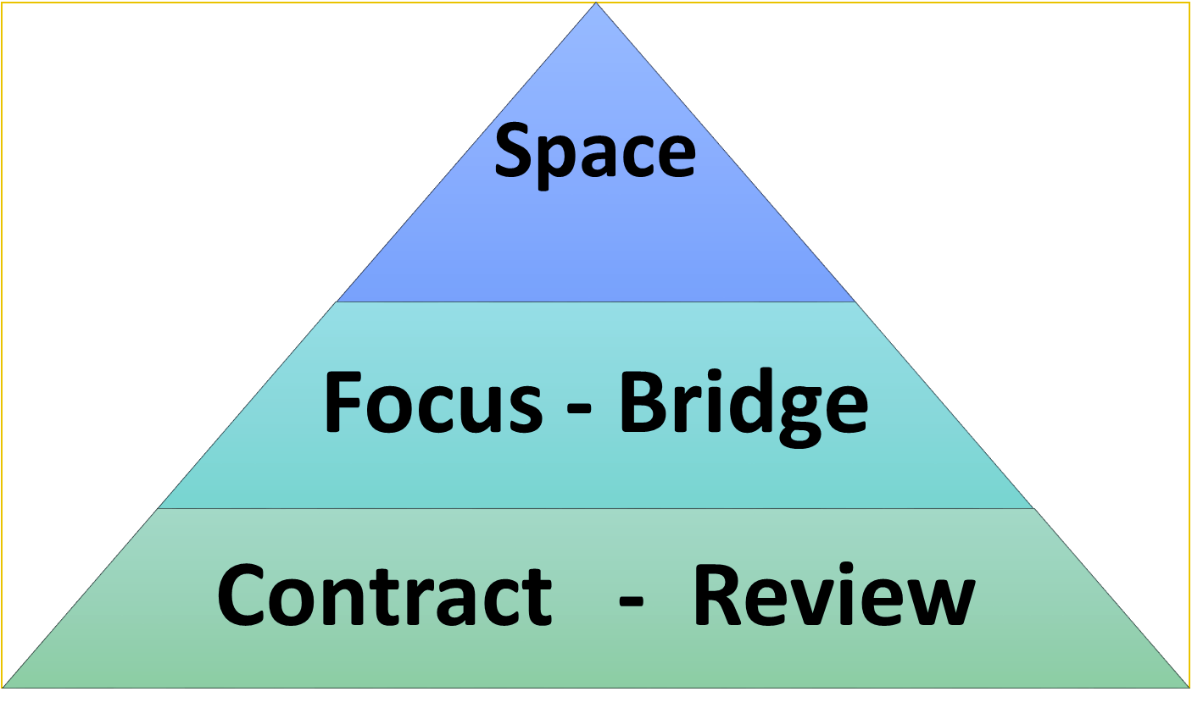
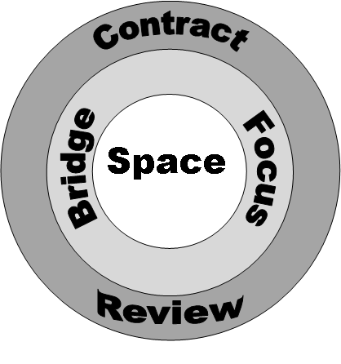
The inter-play between stages
Contract provides the foundation for the other stages,
as supervision progresses Review feeds into (re-)Contracting as well as informing other stages
Focus and Bridge also form a dyad that links in from and back to the content and process of the coaching work
Space sits at the heart, or pinnacle, of the other four stages
Notes:
Let me give you a simple example of my shadow:
I am driving on a motorway or dual carriageway. Roadworks signs come up and then a sign saying the outside lane is going to shut in 800 yards. I move over into the middle lane and slow down as the traffic backs up. Then some other drivers drive up the outside lane and push in further up. I get furious – its really thoughtless, don’t they realise they are causing this tailback? I am incensed. Righteous anger in my view.
One day I have my son in the back of the car. He is about 12-18 months old. He’s poorly with a cold, snotty, upset out of sorts. I can’t reach him and I want to get home, get him out of the car and give him a cuddle and some Calpol.
I come to a roadworks sign and a lane closure sign on the motorway. The traffic is backing up. I think to myself, just this once, to get Dom home. I drive up the outside lane. I start out feeling a bit sheepish, but by halfway along the queue I realise I am feeling really exhilarated, this is great fun, I squeeze into a gap and have to resist putting two fingers up to the driver I push in front of when they flash.

Slide 10
Relationship
Studies in supervision consistently show that the quality of relationship between the supervisor and supervisee is viewed by supervisees as the most critical factor in the overall effectiveness of supervision.
Supervisees are looking for:
Safety – to feel able to share their vulnerabilities and uncertainties,
Equality – a sense of collegiality in the relationship, with appropriate acknowledgment of the intrinsic power imbalance,
Empowerment – to feel trusted and affirmed by their supervisor,
Support and Challenge – in roughly equal measure.
www.steve-page-yorks.co.uk email@steve-page-yorks.co.uk
Notes:
This is just a diagrammatic form of what I a describing – the processes of denial to ourselves and projection are what really buries shadow within our unconscious.

Slide 11
Any questions?
www.steve-page-yorks.co.uk
Notes:
Thank you for your attention, I hope this has been useful
Do we have time for questions or comments?

